Slide 1
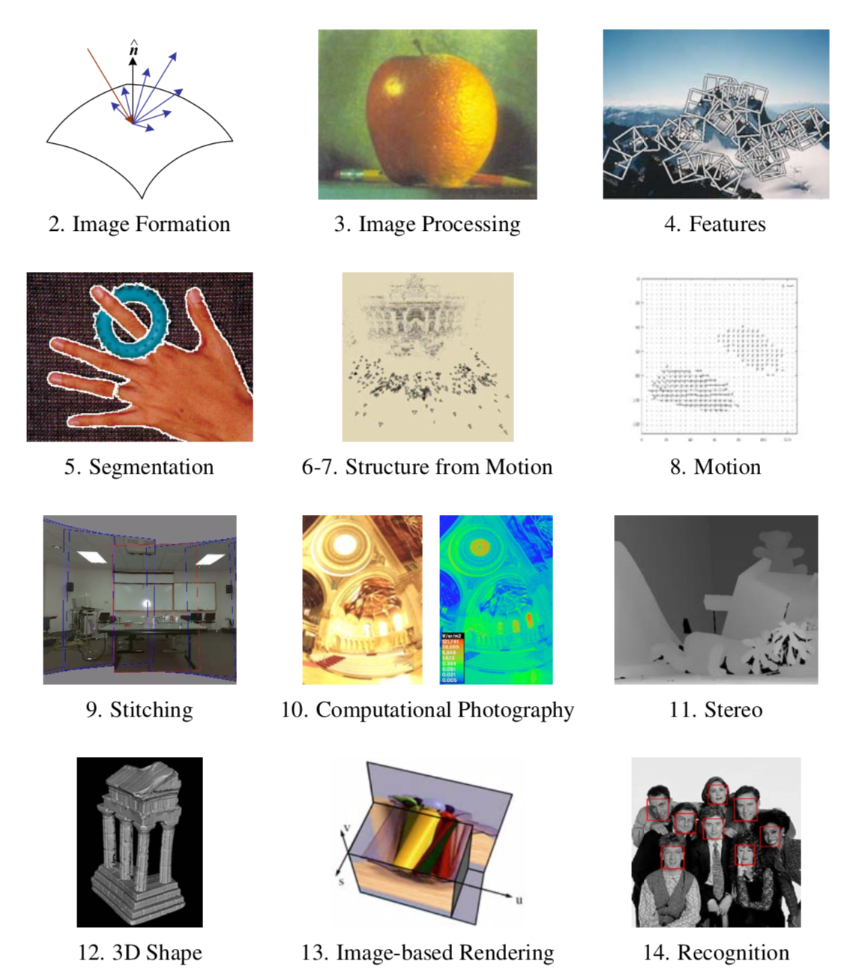

Slide 2
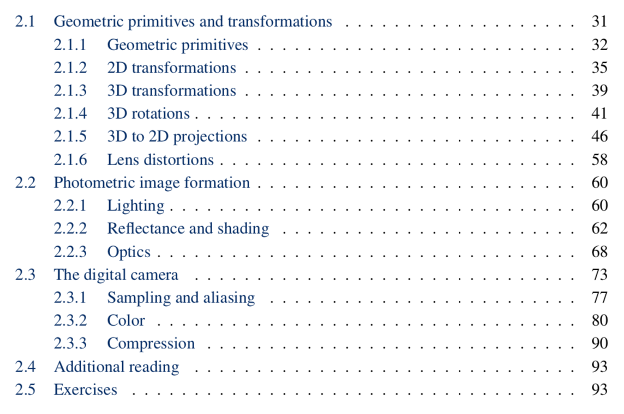
Image Formation

Slide 3


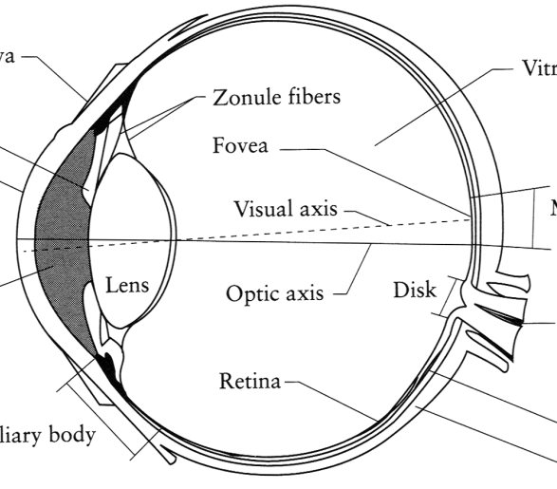
Image Formation
Digital Camera
Film
The Eye

Slide 4
2.2.1 Lighting
Point light source
Area light source
Environment map

Slide 5
Point and area light sources
sun & moon both subtend half a degree
https://blog.demofox.org/2017/07/01/why-are-some-shadows-soft-and-other-shadows-hard/
https://cg-masters.com/nicks-rants-and-raves/contact-shadows-cast-shadows-myth/

Slide 6
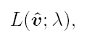
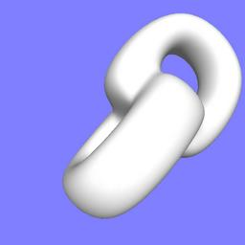
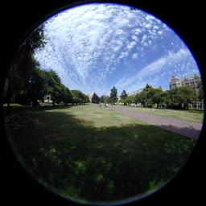
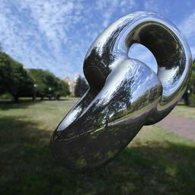
Environment map
http://www.sparse.org/3d.html

Slide 7
2.2.2 Reflectance and Shading
Specular reflection
Diffuse reflection
Oren-Nayar
Phong shading
ambient illumination
Phong formula
BRDF
Isotropic vs anisotropic
Global illumination
Photon’s life choices

Slide 8
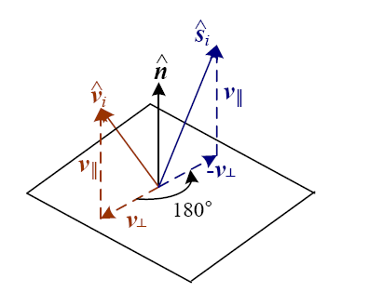
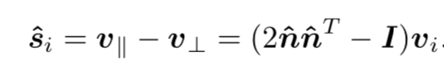
Specular reflection
Specular reflection direction for light source i = deterministic function of incoming light direction v_{i} and normal n:
Photo Carol Highsmith/LOC

Slide 9
Diffuse Reflection
Lambertian
Oren-Nayar
Fully general: BRDF
Trevor Darrell slide

Slide 10
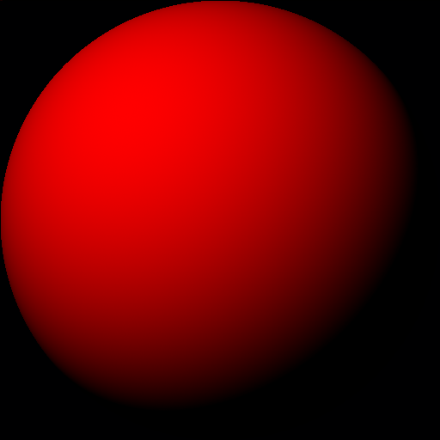
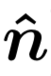
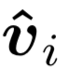
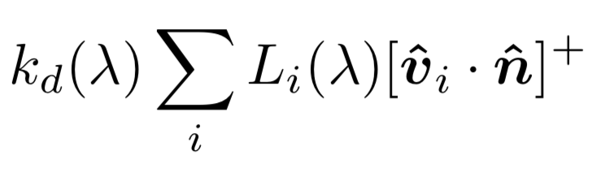
Lambertian Reflectance Model
Surface normal n
Direction of illumination s
A Lambertian sphere
Commonly used in computer vision and computer graphics

Slide 11
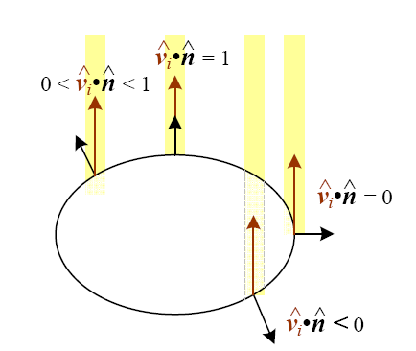
Foreshortening
Trevor Darrell slide

Slide 12
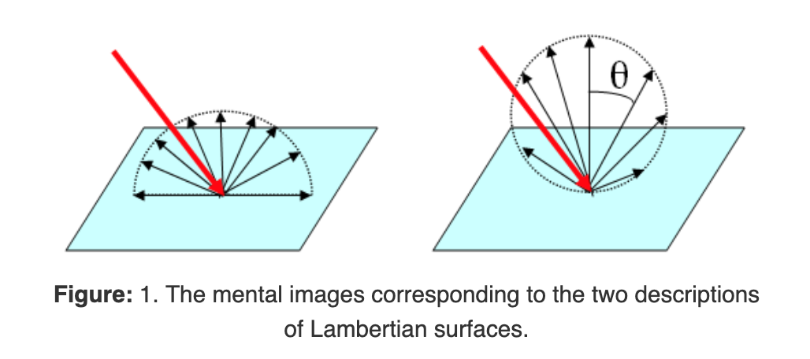
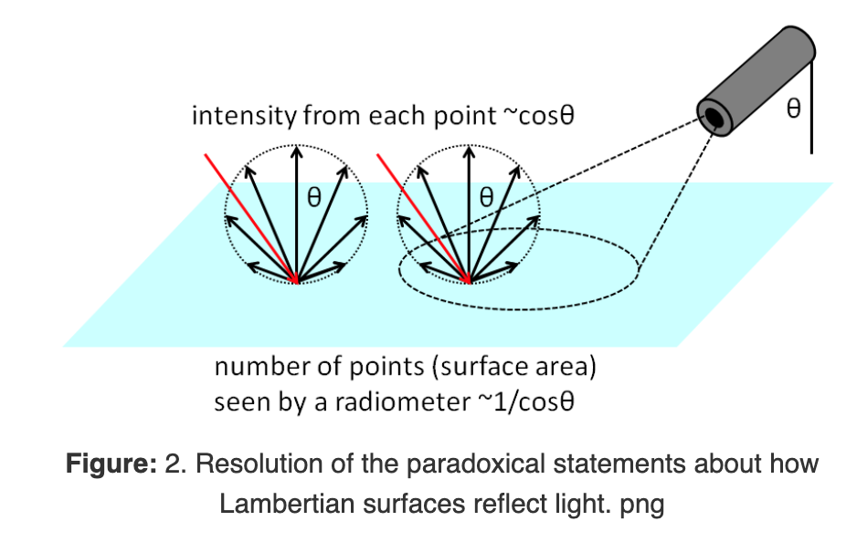
Confusion around Lambert’s cosine law
http://www.oceanopticsbook.info/view/surfaces/lambertian_brdfs

Slide 13
Oren-Nayar Reflectance Model
Moon is a counter-example! Roughness of surface makes that more light is reflected back to the viewer than expected under a Lambertian model.
http://www1.cs.columbia.edu/CAVE/projects/oren/oren.php

Slide 14
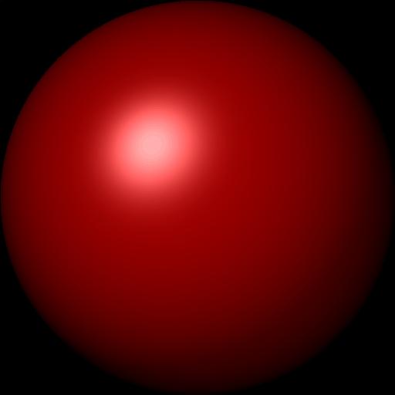
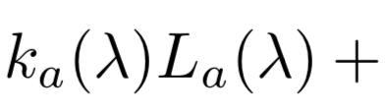
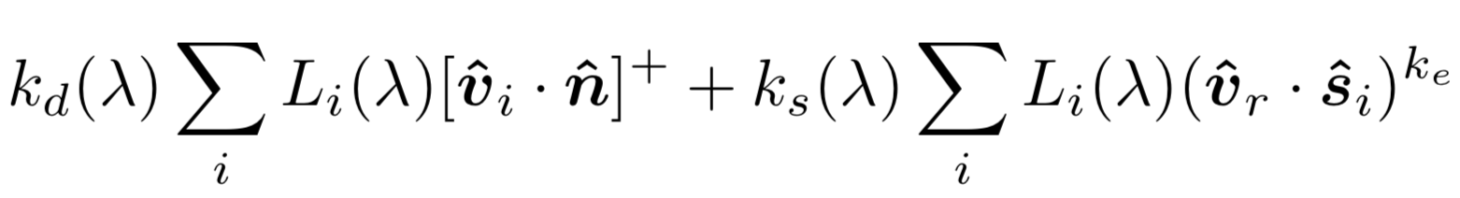
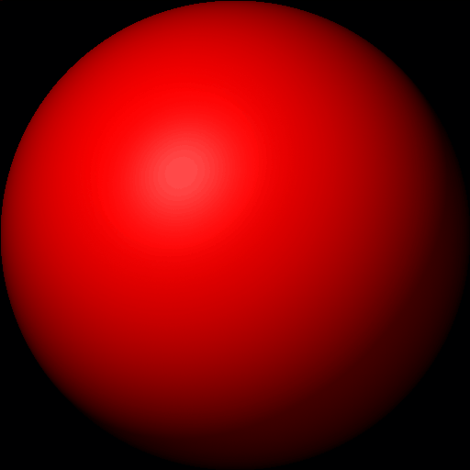
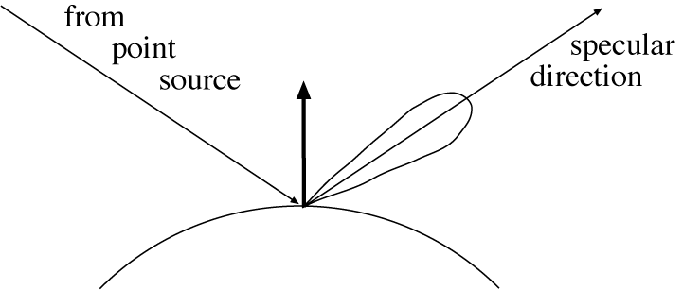
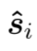
Phong Reflectance Model
Combines diffuse (Lambertian) and specular lobe
frequently with “ambient” component
k_{d}=0.3, k_{s}=0.7, k_{e}=2
diffuse specular
θi
v_{r}: viewing
direction
k_{d}=0.7, k_{s}=0.3, k_{e}=0.5
Based on slide by Ioannis Stamos

Slide 15
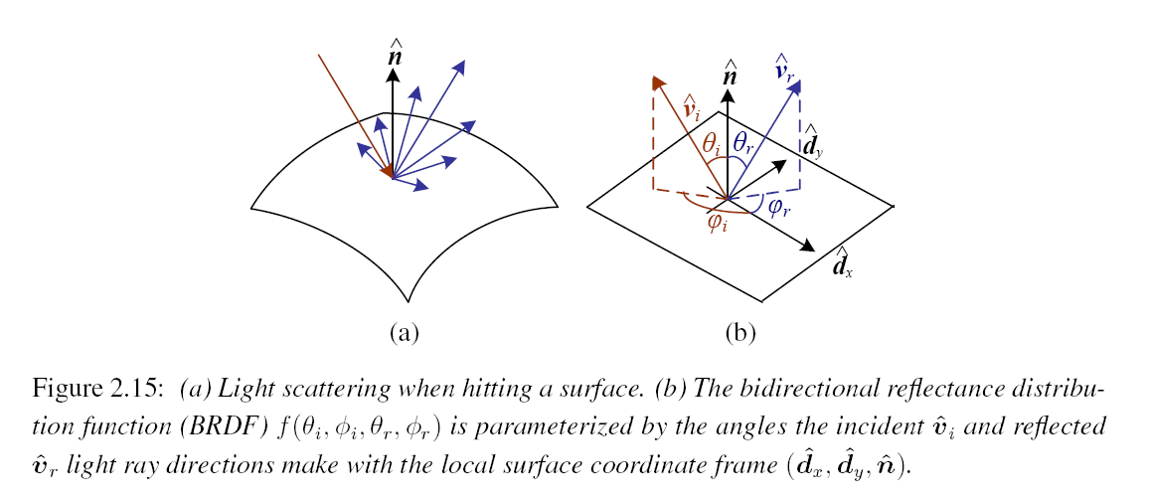
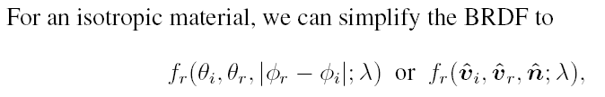
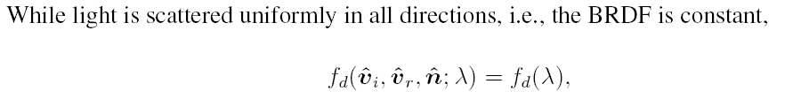
BDRF
Trevor Darrell slide

Slide 16
2.2.3 Optics

Slide 17
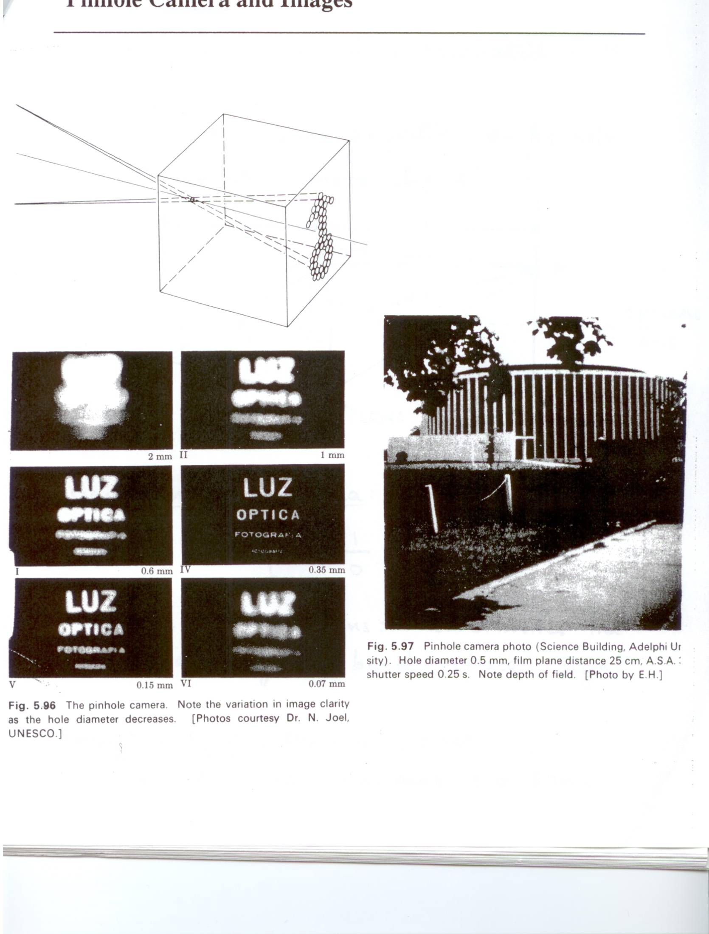
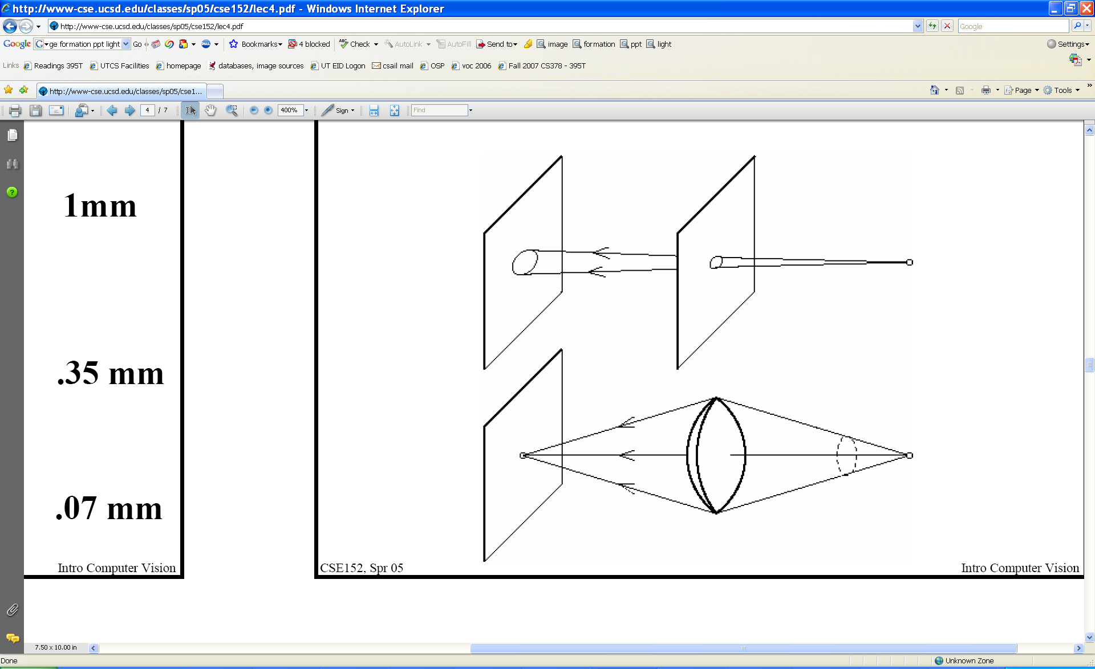
Pinhole size / aperture
How does the size of the aperture affect the image we’d get?
Larger
Smaller
K. Grauman

Slide 18
Adding a lens
focal point
f
A lens focuses light onto the film
Rays passing through the center are not deviated
All parallel rays converge to one point on a plane located at the focal length f
Slide by Steve Seitz

Slide 19
Pinhole vs. lens
K. Grauman

Slide 20
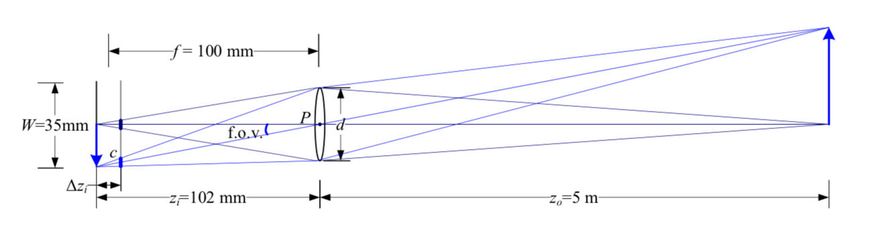
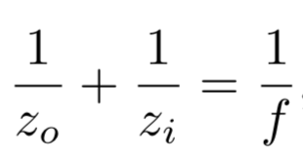
Thin lens model
In a camera, we can adjust image plane to be at z_{i}
If z_{i} == f, focus is at infinity
If we increase zi > f, we bring the focal plane back from infinity.
E.g.: z_{i} == 102mm, f == 100mm => z_{o} == 5m
Image from Szeliski book

Slide 21
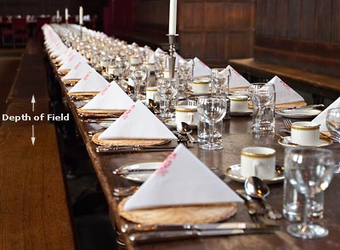
Focus and depth of field
The smaller the aperture (area that lets light through), the more a lens behaves as a pinhole, the more everything is in focus.
Phones: fake “depth of field” with deep learning and stereo ☺
Image credit: cambridgeincolour.com

Slide 22
Image Formation

Slide 23

2.3.0 Human Vision (not in book)
The human eye is a pinhole camera!
Iris - colored annulus with radial muscles
Pupil - the hole (aperture) whose size is controlled by the iris
What’s the “film”?
photoreceptor cells (rods and cones) in the retina
Slide by Steve Seitz

Slide 24
The Retina

Slide 25
Wait, the blood vessels are in front of the photoreceptors??
https://www.youtube.com/watch?v=L_W-IXqoxHA
Notes:
Yes, and you can see them!

Slide 26
Two types of light-sensitive receptors
Cones
cone-shaped
less sensitive
operate in high light
color vision
Rods
rod-shaped
highly sensitive
operate at night
gray-scale vision
© Stephen E. Palmer, 2002

Slide 27
Distribution of Rods and Cones
Night Sky: why are there more stars off-center? Averted vision: http://en.wikipedia.org/wiki/Averted_vision
© Stephen E. Palmer, 2002

Slide 28
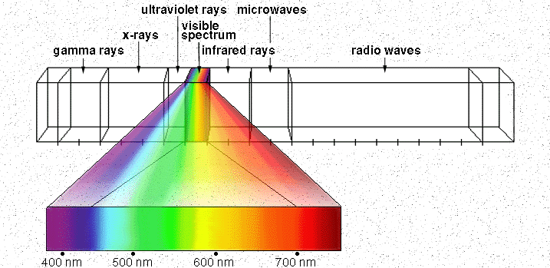
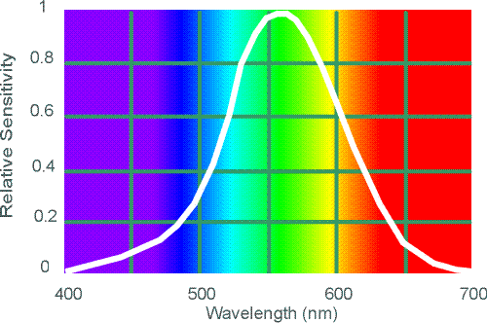
Electromagnetic Spectrum
Human Luminance Sensitivity Function
http://www.yorku.ca/eye/photopik.htm
Notes:
At least 3 spectral bands required (e.g. R,G,B)

Slide 29
The Physics of Light
Some examples of the spectra of light sources
© Stephen E. Palmer, 2002

Slide 30
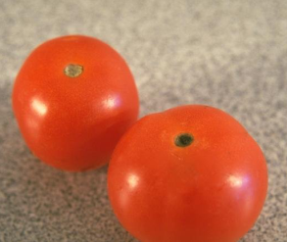
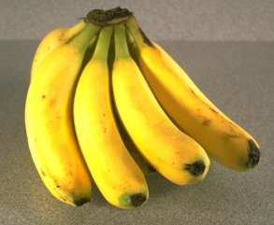
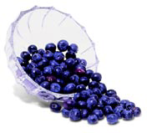
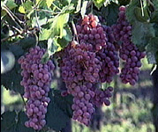
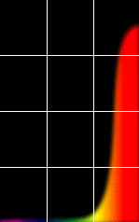
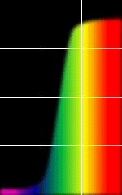
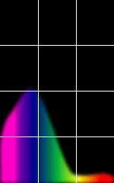
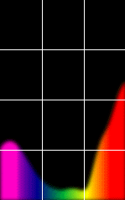
The Physics of Light
Some examples of the reflectance spectra of surfaces
Red
Yellow
Blue
Purple
% Photons Reflected
400 700
400 700
400 700
400 700
Wavelength (nm)
© Stephen E. Palmer, 2002

Slide 31
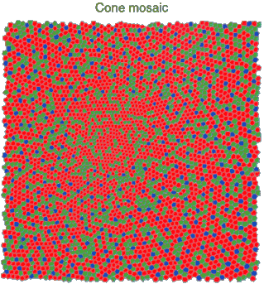
Physiology of Color Vision
Three kinds of cones:
Why are M and L cones so close?
Why are there 3?
© Stephen E. Palmer, 2002

Slide 32
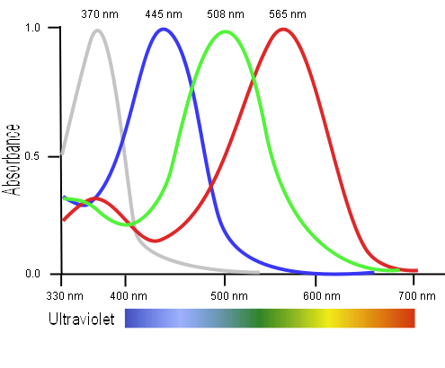
Tetrachromatism
Bird cone responses
Most birds, and many other animals, have cones for ultraviolet light.
Some humans, mostly female, seem to have slight tetrachromatism.

Slide 33
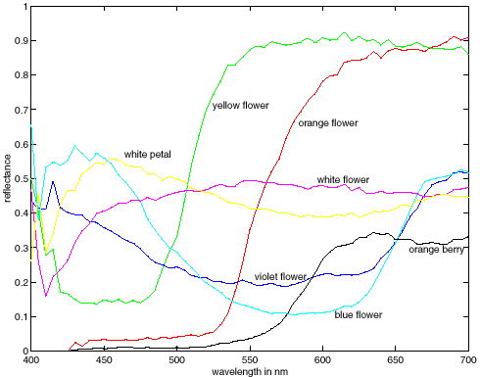
More Spectra
metamers
Notes:
Metamerism can be illuminant based or observer based. Color blindness produced well known instances of metamerism.

Slide 34
Eye Movements
Saccades
Can be consciously controlled. Related to perceptual attention.
200ms to initiation, 20 to 200ms to carry out. Large amplitude.
Micro-saccades
Involuntary
Smaller amplitude
Especially evident during prolonged fixation
Function debated.
Ocular micro tremor (OMT)
Involuntary
High frequency (up to 80Hz)
Small amplitude.
Smooth pursuit
For tracking an object

Slide 35
2.3 The Digital camera
A digital camera replaces film with a sensor array
Each cell in the array is light-sensitive diode that converts photons to electrons
Two common types:
Charge Coupled Device (CCD)
CMOS
http://electronics.howstuffworks.com/digital-camera.htm
Slide by Steve Seitz

Slide 36
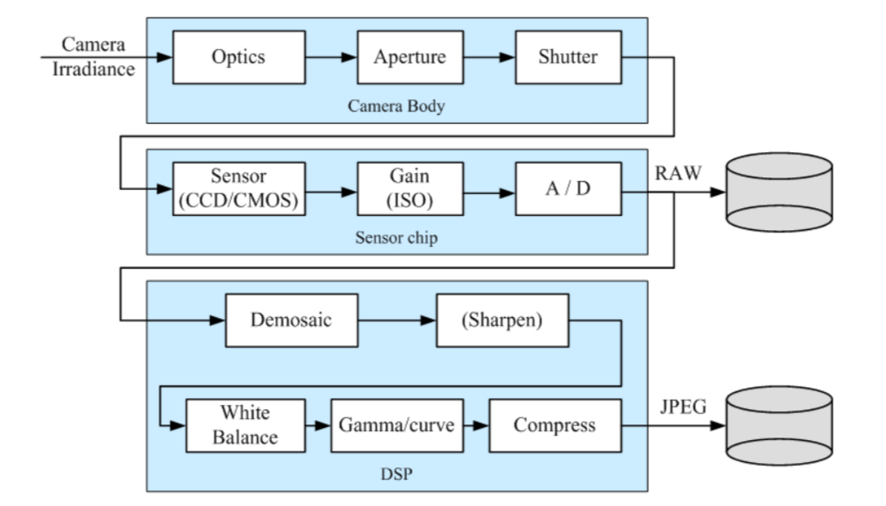
The sensing pipeline

Slide 37
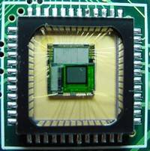
Sensor Array
CMOS sensor

Slide 38
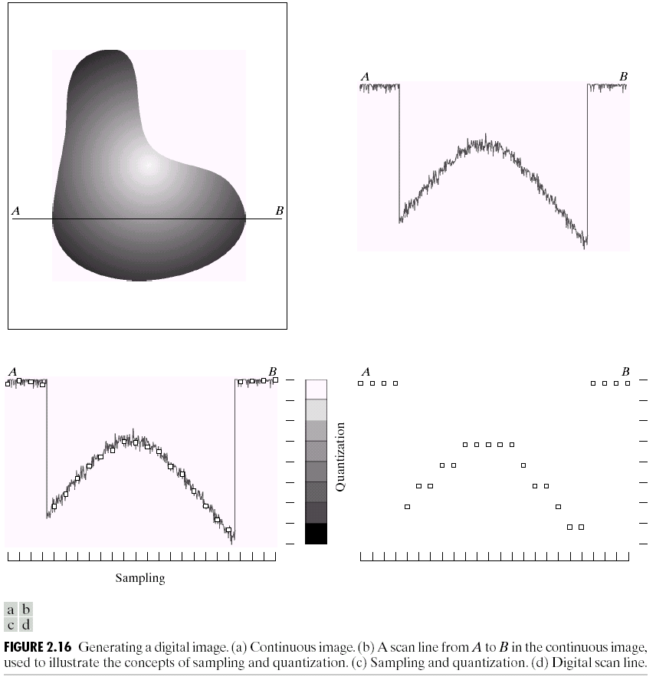
Sampling and Quantization

Slide 39
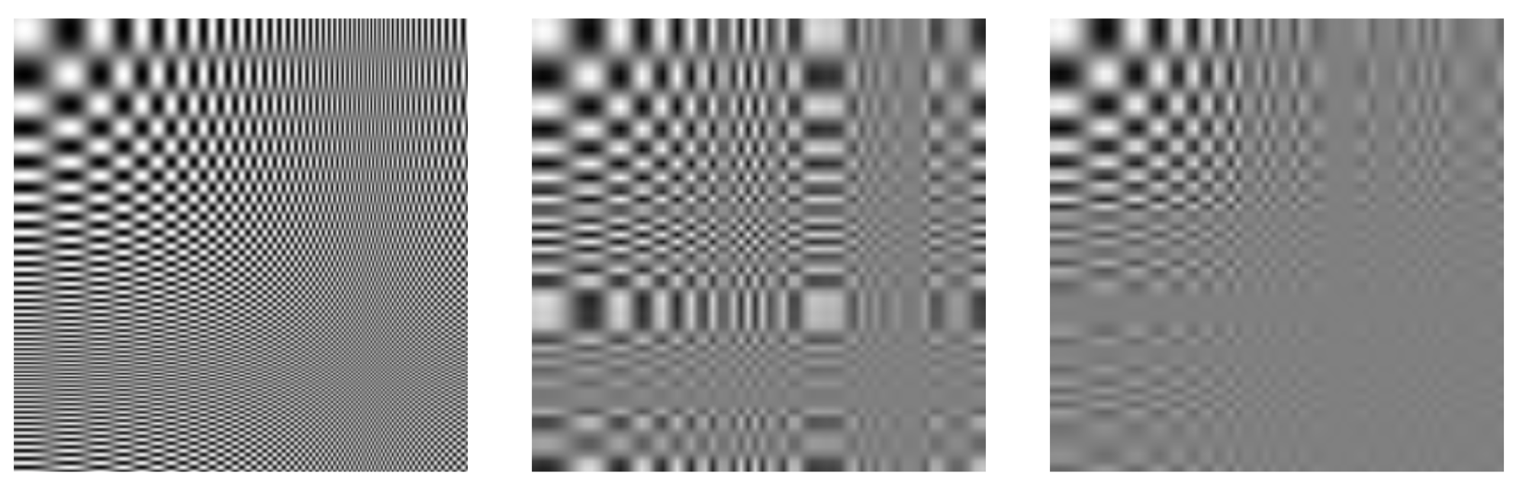
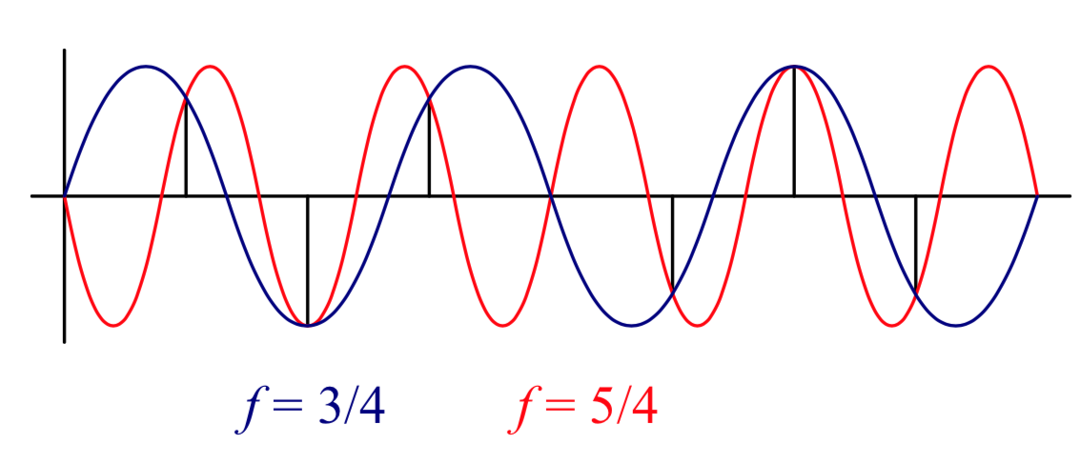
2.3.1 Sampling and Aliasing
Violation of Shannon’s sampling theorem: f_{s} >= 2 f_{max}

Slide 40
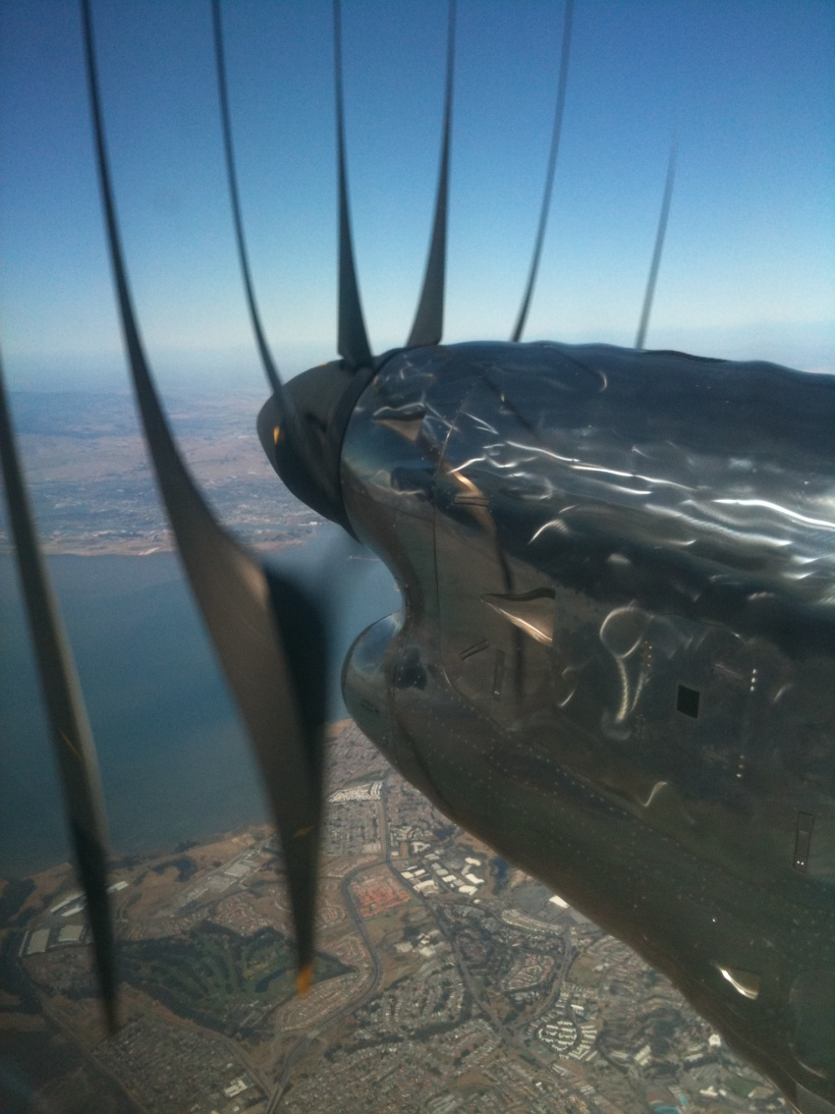
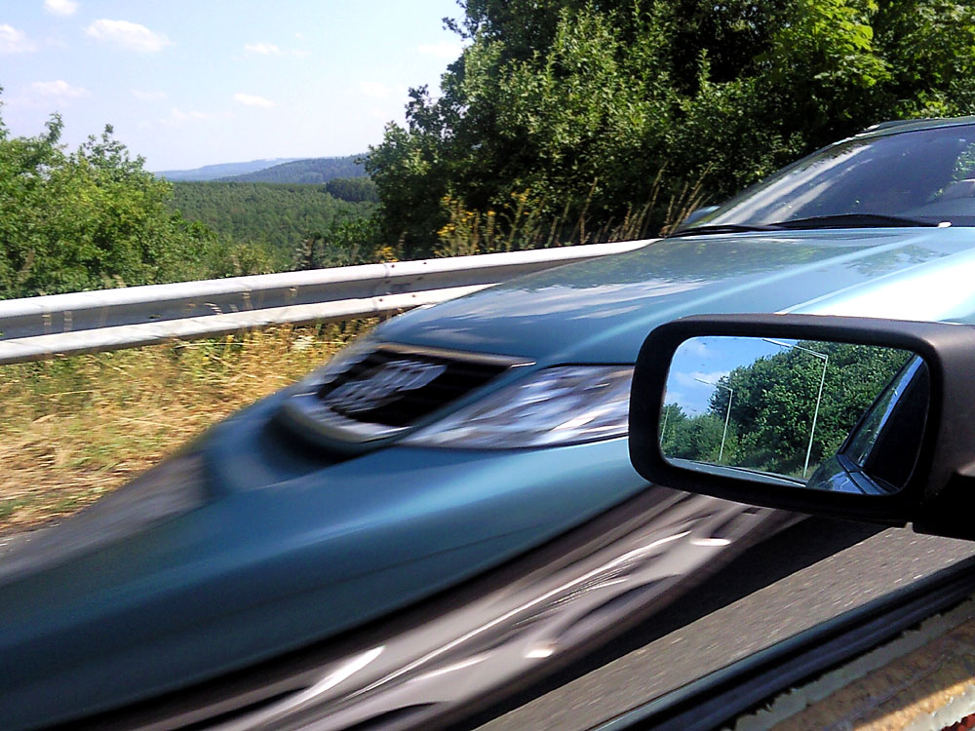
Rolling Shutter
Notes:
http://en.wikipedia.org/wiki/Rolling_shutter
Even DSLRs have this problem.

Slide 41


2.3.2 Color: the Bayer grid
Estimate RGB at ‘G’ cells from neighboring values
Slide by Steve Seitz

Slide 42




Color Image
R
G
B

Slide 43
Images in Matlab Python
Images represented as a matrix
Suppose we have a NxM RGB image called “im”
im(0,0,0) = top-left pixel value in R-channel
im(y, x, b) = y pixels down, x pixels to right in the b^{th} channel
im(N-1, M-1, 2) = bottom-right pixel in B-channel
column
row
R
0.92 | 0.93 | 0.94 | 0.97 | 0.62 | 0.37 | 0.85 | 0.97 | 0.93 | 0.92 | 0.99
0.95 | 0.89 | 0.82 | 0.89 | 0.56 | 0.31 | 0.75 | 0.92 | 0.81 | 0.95 | 0.91
0.89 | 0.72 | 0.51 | 0.55 | 0.51 | 0.42 | 0.57 | 0.41 | 0.49 | 0.91 | 0.92
0.96 | 0.95 | 0.88 | 0.94 | 0.56 | 0.46 | 0.91 | 0.87 | 0.90 | 0.97 | 0.95
0.71 | 0.81 | 0.81 | 0.87 | 0.57 | 0.37 | 0.80 | 0.88 | 0.89 | 0.79 | 0.85
0.49 | 0.62 | 0.60 | 0.58 | 0.50 | 0.60 | 0.58 | 0.50 | 0.61 | 0.45 | 0.33
0.86 | 0.84 | 0.74 | 0.58 | 0.51 | 0.39 | 0.73 | 0.92 | 0.91 | 0.49 | 0.74
0.96 | 0.67 | 0.54 | 0.85 | 0.48 | 0.37 | 0.88 | 0.90 | 0.94 | 0.82 | 0.93
0.69 | 0.49 | 0.56 | 0.66 | 0.43 | 0.42 | 0.77 | 0.73 | 0.71 | 0.90 | 0.99
0.79 | 0.73 | 0.90 | 0.67 | 0.33 | 0.61 | 0.69 | 0.79 | 0.73 | 0.93 | 0.97
0.91 | 0.94 | 0.89 | 0.49 | 0.41 | 0.78 | 0.78 | 0.77 | 0.89 | 0.99 | 0.93
G
0.92 | 0.93 | 0.94 | 0.97 | 0.62 | 0.37 | 0.85 | 0.97 | 0.93 | 0.92 | 0.99
0.95 | 0.89 | 0.82 | 0.89 | 0.56 | 0.31 | 0.75 | 0.92 | 0.81 | 0.95 | 0.91
0.89 | 0.72 | 0.51 | 0.55 | 0.51 | 0.42 | 0.57 | 0.41 | 0.49 | 0.91 | 0.92
0.96 | 0.95 | 0.88 | 0.94 | 0.56 | 0.46 | 0.91 | 0.87 | 0.90 | 0.97 | 0.95
0.71 | 0.81 | 0.81 | 0.87 | 0.57 | 0.37 | 0.80 | 0.88 | 0.89 | 0.79 | 0.85
0.49 | 0.62 | 0.60 | 0.58 | 0.50 | 0.60 | 0.58 | 0.50 | 0.61 | 0.45 | 0.33
0.86 | 0.84 | 0.74 | 0.58 | 0.51 | 0.39 | 0.73 | 0.92 | 0.91 | 0.49 | 0.74
0.96 | 0.67 | 0.54 | 0.85 | 0.48 | 0.37 | 0.88 | 0.90 | 0.94 | 0.82 | 0.93
0.69 | 0.49 | 0.56 | 0.66 | 0.43 | 0.42 | 0.77 | 0.73 | 0.71 | 0.90 | 0.99
0.79 | 0.73 | 0.90 | 0.67 | 0.33 | 0.61 | 0.69 | 0.79 | 0.73 | 0.93 | 0.97
0.91 | 0.94 | 0.89 | 0.49 | 0.41 | 0.78 | 0.78 | 0.77 | 0.89 | 0.99 | 0.93
B
0.92 | 0.93 | 0.94 | 0.97 | 0.62 | 0.37 | 0.85 | 0.97 | 0.93 | 0.92 | 0.99
0.95 | 0.89 | 0.82 | 0.89 | 0.56 | 0.31 | 0.75 | 0.92 | 0.81 | 0.95 | 0.91
0.89 | 0.72 | 0.51 | 0.55 | 0.51 | 0.42 | 0.57 | 0.41 | 0.49 | 0.91 | 0.92
0.96 | 0.95 | 0.88 | 0.94 | 0.56 | 0.46 | 0.91 | 0.87 | 0.90 | 0.97 | 0.95
0.71 | 0.81 | 0.81 | 0.87 | 0.57 | 0.37 | 0.80 | 0.88 | 0.89 | 0.79 | 0.85
0.49 | 0.62 | 0.60 | 0.58 | 0.50 | 0.60 | 0.58 | 0.50 | 0.61 | 0.45 | 0.33
0.86 | 0.84 | 0.74 | 0.58 | 0.51 | 0.39 | 0.73 | 0.92 | 0.91 | 0.49 | 0.74
0.96 | 0.67 | 0.54 | 0.85 | 0.48 | 0.37 | 0.88 | 0.90 | 0.94 | 0.82 | 0.93
0.69 | 0.49 | 0.56 | 0.66 | 0.43 | 0.42 | 0.77 | 0.73 | 0.71 | 0.90 | 0.99
0.79 | 0.73 | 0.90 | 0.67 | 0.33 | 0.61 | 0.69 | 0.79 | 0.73 | 0.93 | 0.97
0.91 | 0.94 | 0.89 | 0.49 | 0.41 | 0.78 | 0.78 | 0.77 | 0.89 | 0.99 | 0.93

Slide 44

Color spaces
How can we represent color?
http://en.wikipedia.org/wiki/File:RGB_illumination.jpg

Slide 45





Color spaces: RGB
Default color space
0,1,0
R
(G=0,B=0)
1,0,0
G
(R=0,B=0)
0,0,1
B
(R=0,G=0)
Some drawbacks
Strongly correlated channels
Non-perceptual
Image from: http://en.wikipedia.org/wiki/File:RGB_color_solid_cube.png

Slide 46




Color spaces: HSV
Intuitive color space
H
(S=1,V=1)
S
(H=1,V=1)
V
(H=1,S=0)

Slide 47






Color spaces: YCbCr
Fast to compute, good for compression, used by TV
Y=0
Y=0.5
Y
(Cb=0.5,Cr=0.5)
Cr
Cb
(Y=0.5,Cr=0.5)
Cb
Y=1
Cr
(Y=0.5,Cb=05)

Slide 48




Color spaces: L*a*b*
“Perceptually uniform”* color space
L
(a=0,b=0)
a
(L=65,b=0)
b
(L=65,a=0)

Slide 49
If you had to choose, would you rather go without luminance or chrominance?

Slide 50
If you had to choose, would you rather go without luminance or chrominance?

Slide 51

Most information in intensity
Only color shown – constant intensity

Slide 52

Most information in intensity
Only intensity shown – constant color

Slide 53
Most information in intensity
Original image

Slide 54

2.3.3 Compression

